Slide 1
EV range prediction
Input- Atmosphere + car variable+ Fuel left
Output-KMs it can go with these condition

Slide 2
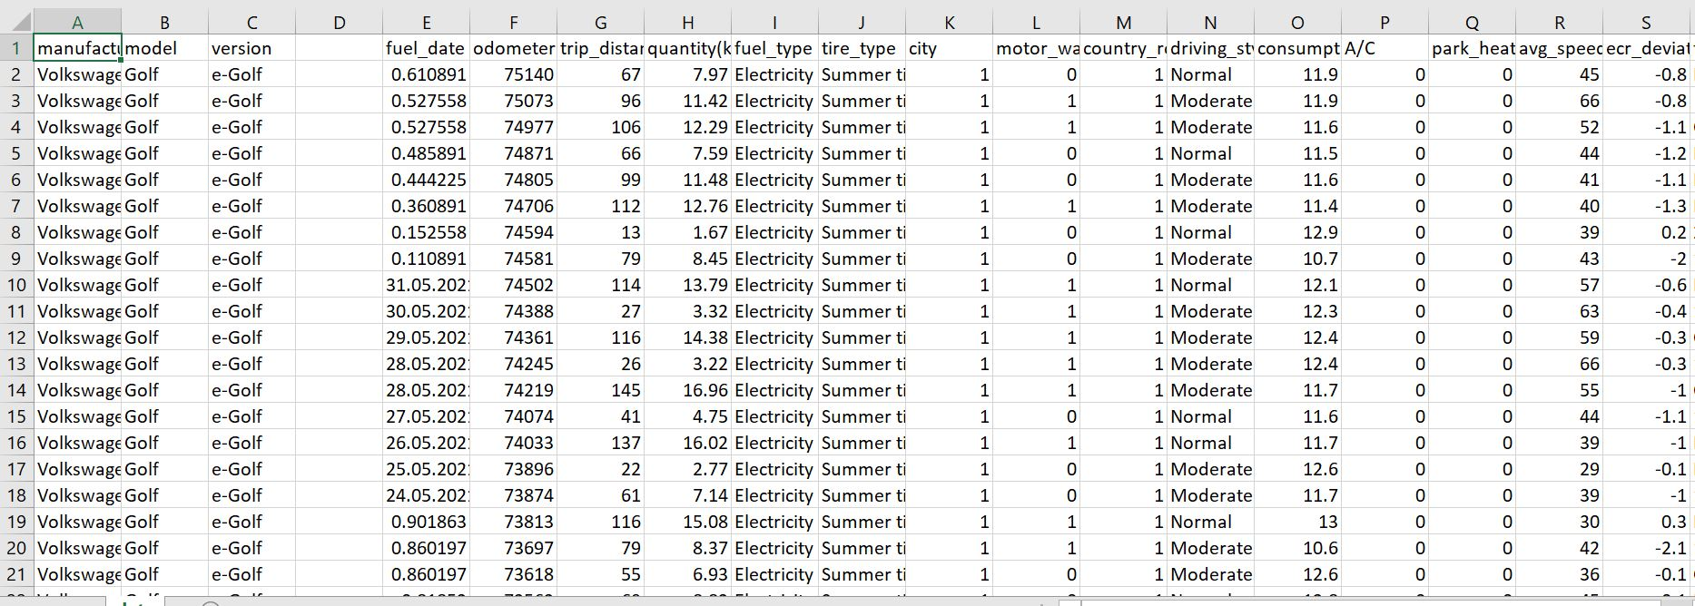
Data used

Slide 3
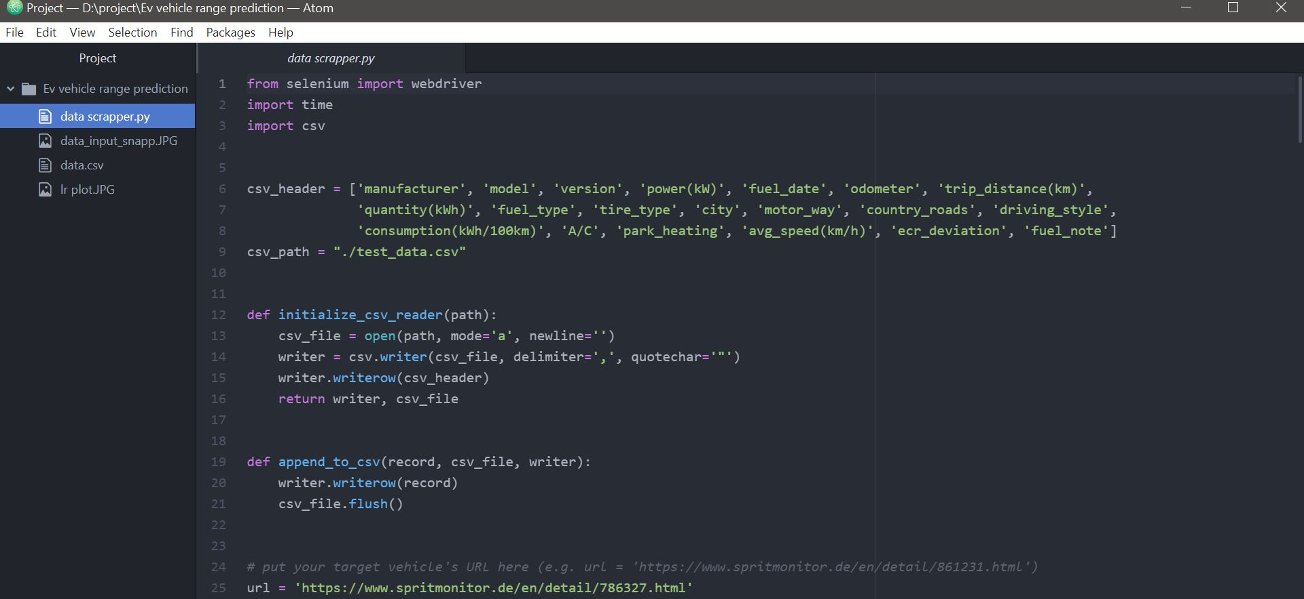
How data is extracted: Data is scrapped from https://www.spritmonitor.de/en/detail/786327.html Data is of only 1 car tho data of other cars can also be merged later in the project

Slide 4
Objective of Project
Do exploratory data analysis and find useful features for prediction
Apply features regularisation to improve accuracy on our model
Try out various models to perform regression on given data and compare their accuracy and errors

Slide 5
Application of our study
Improved range prediction system
Find out variable which influences battery_average of our vehicle and ways to increase it.
Predicting how these vehicle will perform on Indian roads consedring various factor as terrain, weather , driving style, road conditions etc.

Slide 6
Add ons we can try on our project
Try our model on different cars and different input data
1
Feature encode various input to gain different result
2
Also add deep learning models to predict outcome
3

Slide 7
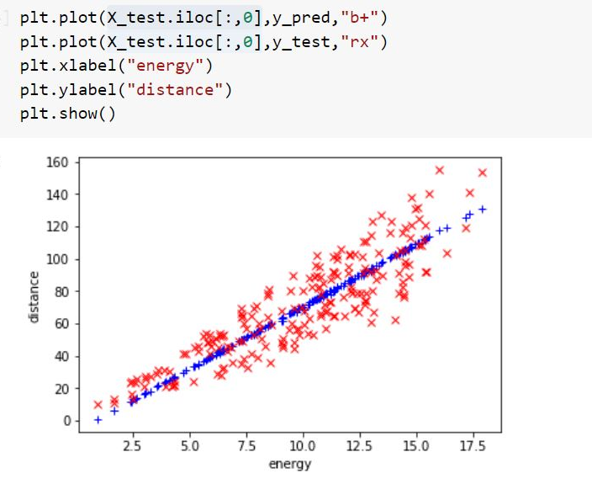
Sample regression(try)

